Slide 1
Cloud Platform: AWS – S3, SimpleDB, RDB
Prof. Tahar Kechadi
School of Computer Science

Slide 2
Learning Outcomes
Understand Large Scale Data Storage with S3
What are the main S3 concepts
Other AWS offerings

Slide 3
Amazon S3
Amazon S3
Very large scale data storage cloud service, called simple storage service (S3)
S3 Access
Uses web services interface to store and retrieve data, at any time, and from anywhere
S3 Features
Amazon S3 duplicates the data
No setup fee, no monthly minimum
Each object is assigned a unique key by the developer/user
Authentication mechanisms
Pricing of storage and transfer varies depending on the usage
Private and public storage
Each object up to 5GB in size, unlimited amount of objects
Location can be chosen
Notes:
Amazon’s S3 holds more than a trillion objects (up to 5 terabytes in size each), and processes up to 650,000 requests per second at peak times! (Q1, 2012).

Slide 4
S3 - Components
Object
Is the fundamental storage entity in S3
It is composed of object data and metadata
Bucket
Is a container for objects
Every object is contained within a bucket
Key
Is a unique identifier for an object within a bucket
Every object has exactly one key
Notes:
You can securely upload/download your data to Amazon S3 via the SSL encrypted endpoints using the HTTPS protocol.

Slide 5
S3 – Components (2)
Object Name
Consists of bucket name + key
Object Access
Requires authentication, unless the owner of an object has specifically granted anonymous access to an object or bucket
AWS Access Key required by S3
Notes:
Service endpoint + bucket + key

Slide 6
S3 - Operations
Common operations:
Create a bucket (CreateBucket)
Write an object (PutObjectInline)
Read an object (GetObject)
Delete an object (DeleteObject)
List keys (ListBucket)
Etc.
API operations & Examples of how to use the service, bucket, object, etc.:
http://docs.amazonwebservices.com/AmazonS3/latest/API/

Slide 7
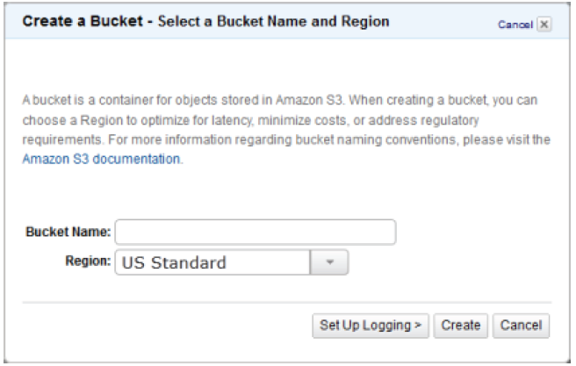
Amazon S3

Slide 8
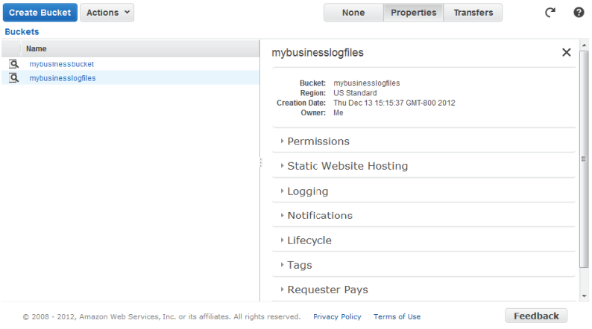
Amazon S3

Slide 9
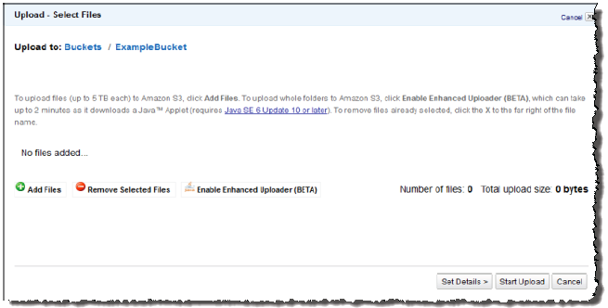
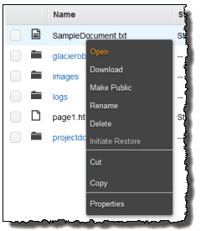
Amazon S3

Slide 10
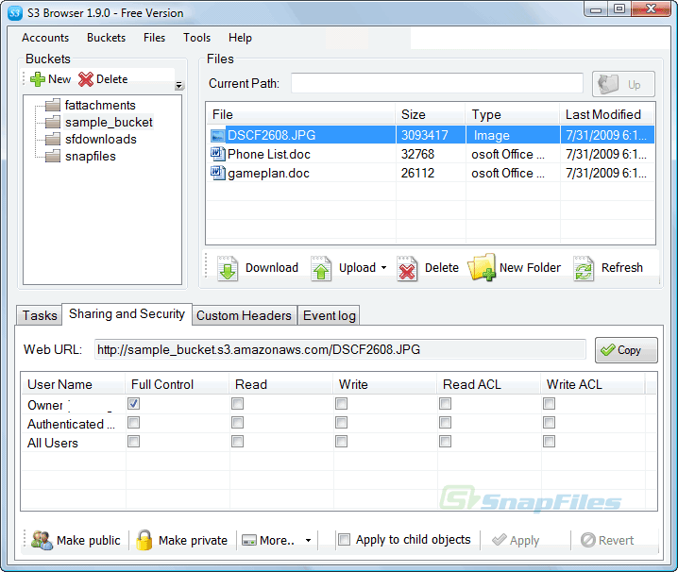
S3 Browser
S3 Browser

Slide 11
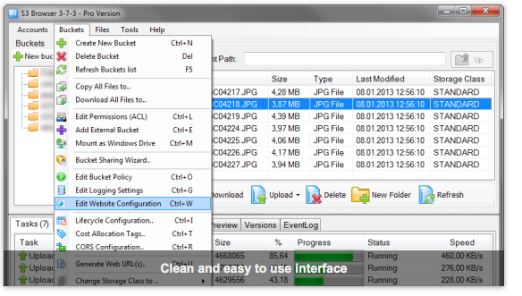
S3 Browser

Slide 12
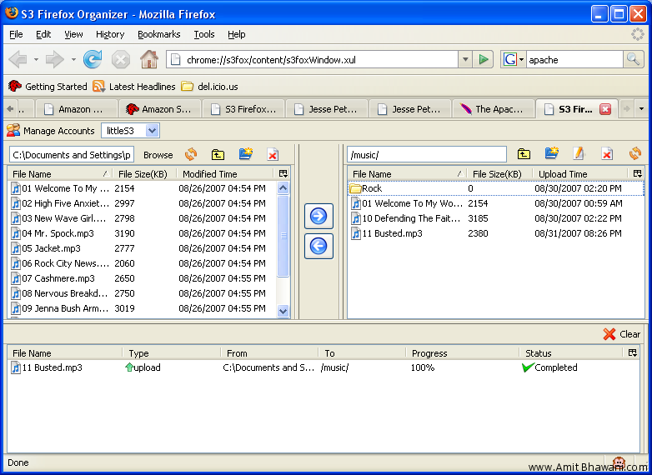
S3 - Firefox Organiser
S3 Firefox Organiser (https://addons.mozilla.org/en-US/firefox/addon/amazon-s3-organizers3fox/)

Slide 13
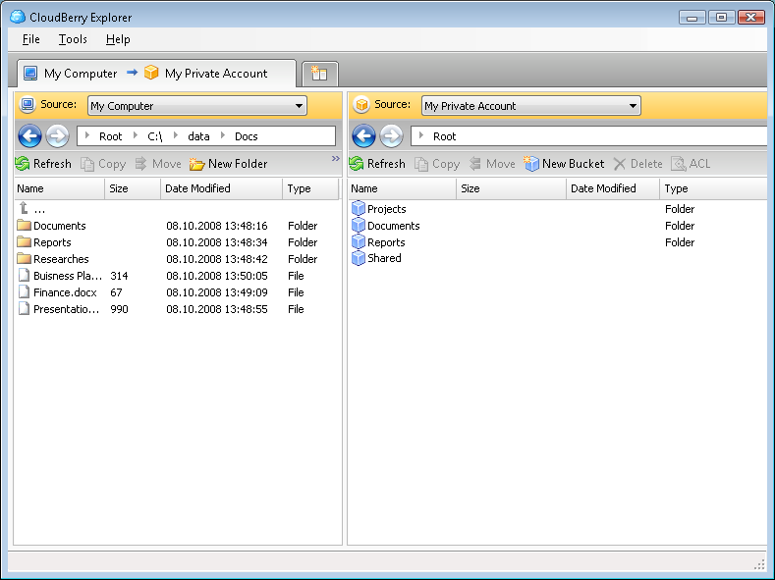
S3 - CloudBerry
S3 CloudBerry Explorer

Slide 14
Relational databases vs. Non-relational databases
Relational Database
Tables, Key
Integrity Rules (distinct, not be repeating, primary key, etc.)
Database Normalisation
Consistency
SQL
RDBMS
Big Data
Volume
Velocity
Variety
Veracity
Viscosity
“Big data is like teenage ---: everyone talks about it, nobody really knows how to do it, everyone thinks everyone else is doing it, so everyone claims they are doing it.”
–Dan Ariely
Notes:
One of the key aspects associated to NoSQL is related to consistency. A common term often associated to these technologies is eventual consistency. Consistency essentially means that a read would always returns the most up-to-date written value. When scaling data stores at a very large scale, expecting to operate on a single global state without creating a bottleneck somewhere is somehow hard to achieve. NoSQL eases this by making certain trade-offs between consistency and availability, c.f. CAP theorem.
“Big data is like teenage ---: everyone talks about it, nobody really knows how to do it, everyone thinks everyone else is doing it, so everyone claims they are doing it.” (Dan Ariely)

Slide 15
Relational databases vs. Non-relational databases (2)
Issues with Relational Database
Lots of data
Distribution
Not scalable
…
CAP theorem (Eric Brewer, 2000)
Consistency
Availability
Partition-tolerance
Notes:
Consistency (every read receives the most recent write or an error)
Availability (every request receives a response, without guarantee that it contains the most recent version of the information)
Partition tolerance (the system continues to operate despite arbitrary partitioning due to network failures)

Slide 16
Relational databases vs. Non-relational databases (3)
New kinds of DBMS: non-relational
BigTable
Hbase
Dynamo
MongoDB
Advantages
Scalable
Fast
Highly available, dencentralised, fault-tolerant
Parallel processing
…

Slide 17
Amazon SimpleDB
Amazon SimpleDB
Is a non-relational data store
It provides the core database functions of data indexing and querying non-relational DB
SimpleDB Features
No need to pre-define schema
Store and retrieve structured data
Optional consistent reads
No transactions, conditional put/delete
Notes:
One of the key aspects associated to NoSQL is related to consistency. A common term often associated to these technologies is eventual consistency. Consistency essentially means that a read would
always returns the most up-to-date written value. When scaling data stores at a very large scale, expecting to operate on a single global state without creating a bottleneck somewhere is somehow
hard to achieve. NoSQL eases this by making certain trade-offs between consistency and availability, c.f. CAP theorem.

Slide 18
Amazon SimpleDB
Domains
Containers to store and query structured data (similar to spreadsheet)
No cross domain querying
Items
Individual objects within domains (similar to a row in worksheet)
Attributes
Categories of data that can be assigned to items
Values
Instances of attributes for items. An attribute can have multiple values.

Slide 19
SimpleDB Operations
Operations include:
CreateDomain, DeleteDomain, ListDomains
PutAttributes
BatchPutAttributes
DeleteAttributes
GetAttributes
Select, etc.
http://docs.aws.amazon.com/AmazonSimpleDB/latest/DeveloperGuide/Welcome.html

Slide 20
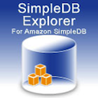
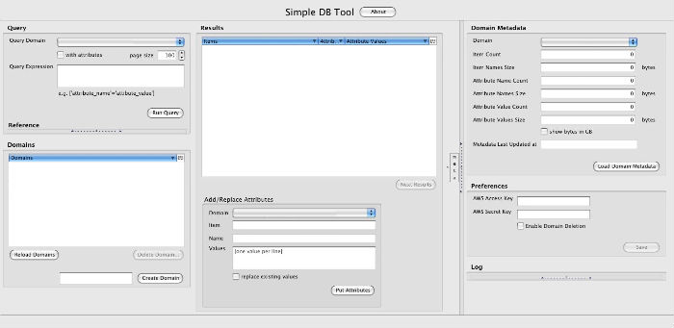
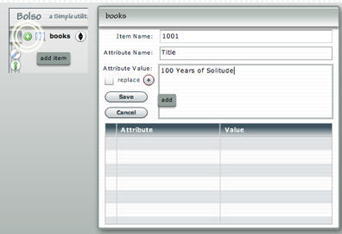
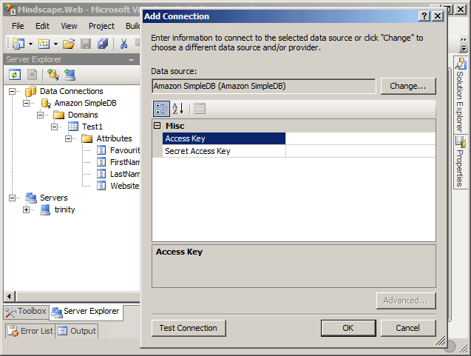
Amazon SimpleDB
Bizo
Bolso
MindScape

Slide 21
Amazon RDS
Amazon RDS (Relational DB)
It provides resizable database capacity while managing time-consuming database admin tasks
RDB Features
Full capabilities of MySQL/Oracle/SQL Servers
Automated backups
DB snapshots
Multi-Availability Zone deployments
Enhanced availability though multiple availability zones

Slide 22
RDS use & operations
RDS Use
Easy to deploy, manage, secure,
Use AWS Management Console/API to launch a database instance (DB Instance)
Connect to DB Instance with any MySQL supported tool
Like other services, easy to monitor through Amazon CloudWatch
It is scalable, and reliable
Some common operations
CreateDBInstance
ModifyDBInstance
CreateDBSnapshot, etc.
http://docs.aws.amazon.com/AmazonRDS/latest/APIReference/Welcome.html

Slide 23
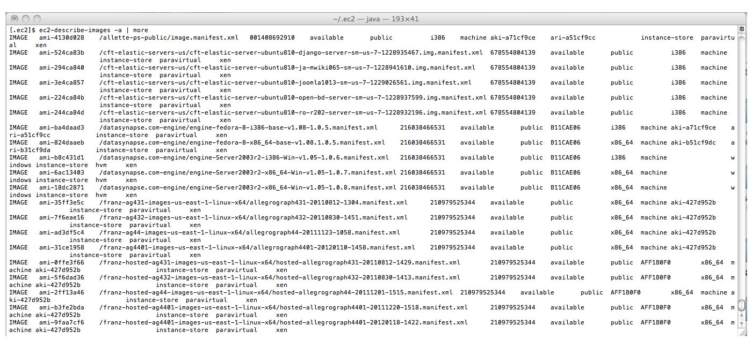
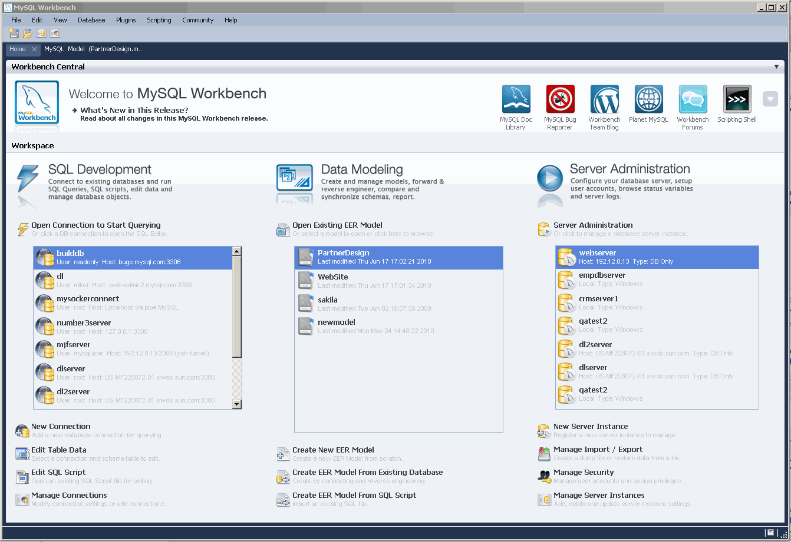
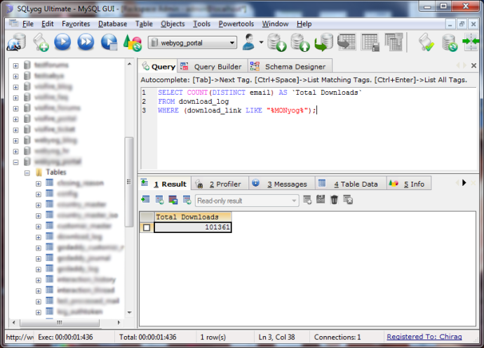
Amazon RDS
RDS CLI
Monyog
MySQL Workbench
Notes:
MONyog is a monitoring and advisory tool for MySQL Community, MySQL Enterprise and MariaDB. This software is created by Webyog Inc. based out of Bangalore, India and Santa Clara, California.
The most secure and scalable MySQL monitoring tool…

Slide 24
RDS vs. SimpleDB
SimpleDB
Scales up/down automatically
Highly available (no downtime)
No joins, no transactions, more flexible
RDS
Existing applications that require relational database
Need to decide the scaling decisions
How much storage, what size instance, etc.

